Slide 1
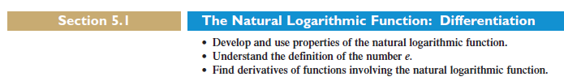
Logarithmic Function:
The logarithmic function is defined by
Where a is non-negative positive number but not equal to 1)
If a=10 the logarithm is known as common logarithm and
If a=e (e is Euler’s Constant) then logarithm is known as Natural logarithm.

Slide 3
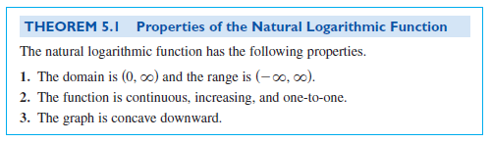
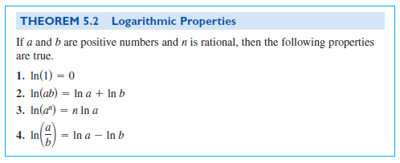
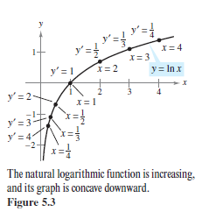

Slide 4
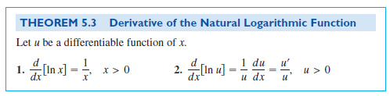
Try to prove by using the ab-initio method

Slide 5
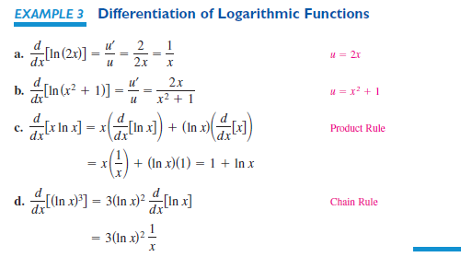

Slide 6
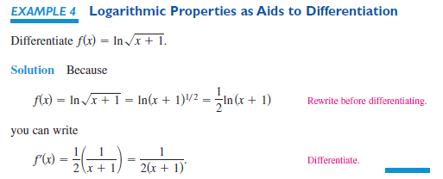

Slide 7
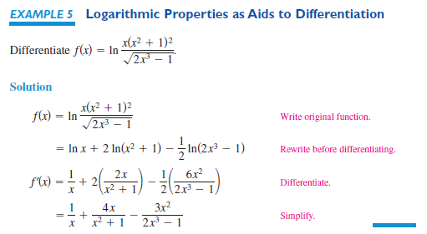

Slide 8
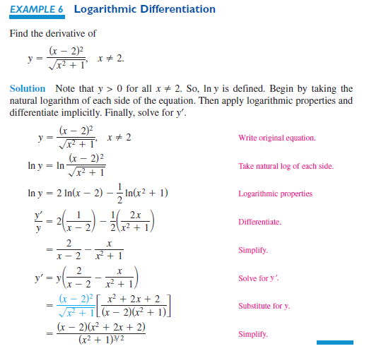

Slide 9
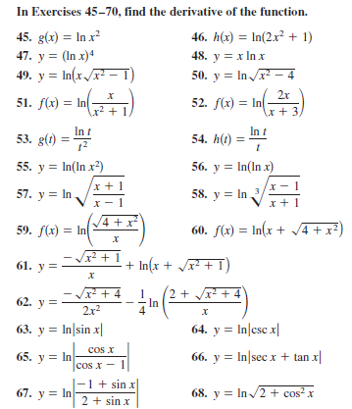

Slide 10
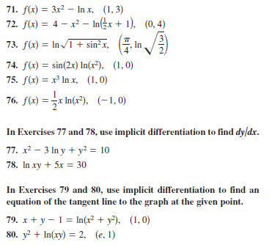
Find the equation of the tangent line at the given point to the curve

Slide 11
